Slide 1
ICS 3103:Data Communications
Lecture: Measures of Information
By Cheruiyot W.K, PhD,
JKUAT-SCIT,
Computing Department

Slide 2
Schematic of Relationships among Terms
Relationships among relevant terms as used:
Facts are represented by Data.
Data are processed to produce Information.
Information is communicated, leading to Understanding.
Understanding is integrated together to become Knowledge
Knowledge is used to make Decisions.
Fact —— Data —— Information —— Understanding —— Knowledge —— Decisions
\ / \ / \ / \ / \ /
Represent Process Communicate Integrate Use
\———————————————————————————/ \——————————————————————————————————————/
EXTERNAL TO RECIPIENT INTERNAL TO RECIPIENT

Slide 3
Information
What does a word “information” mean?
No some exact definition, however:
Information carries new specific knowledge, which is definitely new for its recipient;
Information is always carried by some specific carrier in different forms (letters, digits, different specific symbols, sequences of digits, letters, and symbols , etc.);
Information is meaningful only if the recipient is able to interpret it.

Slide 4
Information
The information materialized as a message.
Information is always about something (size of a parameter, occurrence of an event, etc).
Viewed in this manner, information does not have to be accurate; it may be a truth or a lie.
Even a disruptive noise used to inhibit the flow of communication and create misunderstanding would in this view be a form of information.
However, generally speaking, if the amount of information in the received message increases, the message is more accurate.

Slide 5
Information Source
4 characteristics of information source
    The no. of symbols, n
    The symbols, S₁, S₂, …, S_{n}
    The probability of occurrence of each symbol, P(S₁), P(S₂), …, P(S_{n})
    The correlation between successive symbols
Some definitions:
  Memoryless source: if each symbol is independent
  A message: a stream of symbols from the senders to the receiver

Slide 6
Examples …
Ex. 1.: A source that sends binary information (streams of 0s and 1s) with each symbol having equal probability and no correlation can be modeled as a memoryless source
    n = 2
    Symbols: 0 and 1
    Probabilities: p(0) = ½ and P(1) = ½

Slide 7
Definition of Information as a Result of Data Processing
Information is that property of data (i.e., recorded symbols) which represents (and measures) effects of processing of them.

Slide 8
Information Theory
How we can measure the amount of information?
How we can ensure the correctness of information?
What to do if information gets corrupted by errors?
How much memory does it require to store information?

Slide 9
Information Theory
Basic answers to these questions that formed a solid background of the modern information theory were given by the great American mathematician, electrical engineer, and computer scientist Claude E. Shannon in his paper “A Mathematical Theory of Communication” published in “The Bell System Technical Journal” in October, 1948.

Slide 10
Information theory
Information theory-founded by Claude E. Shannon in 1948-provides a mathematical frame- work for the theory of communication; it describes the fundamental limits to how
Efficiently one can encode information and still be able to recover it with negligible loss.

Slide 11
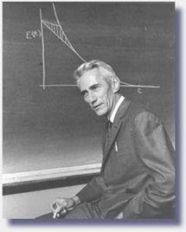
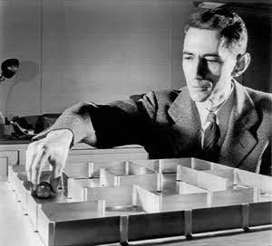
Claude Elwood Shannon (1916-2001)
The father of information theory
The father of practical digital circuit design theory
Bell Laboratories (1941-1972), MIT(1956-2001)

Slide 12
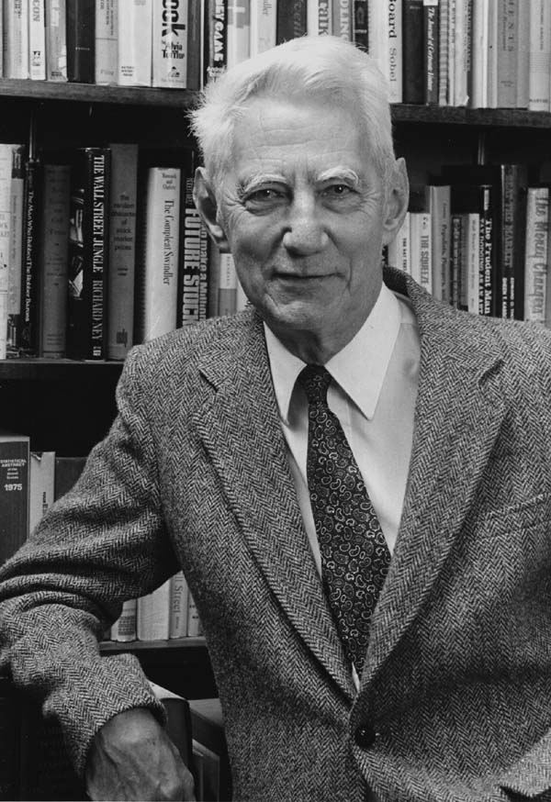
Information theory and entropy
Information theory tries to solve the problem of communicating as much data as possible over a noisy channel
Measure of data is entropy
Claude Shannon first demonstrated that reliable communication over a noisy channel is possible (jump-started digital age)

Slide 13
"The fundamental problem of communication is that of reproducing at one point, either exactly or approximately, a message selected at another point."
-Shannon, 1944

Slide 14
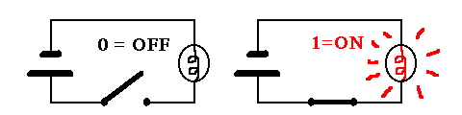
Information Content
What is the information content of any message?
Shannon’s answer is: The information content of a message consists simply of the number of 1s and 0s it takes to transmit it.

Slide 15
Information Content
Hence, the elementary unit of information is a binary unit: a bit, which can be either 1 or 0; “true” or “false”; “yes” or “know”, “black” and “white”, etc.
One of the basic postulates of information theory is that information can be treated like a measurable physical quantity, such as density or mass.

Slide 16
Two main questions of
Information Theory
What to do if information gets corrupted by errors?
How much memory does it require to store data?
Both questions were asked and to a large degree answered by Claude Shannon in his 1948 seminal article: use error correction and data compression

Slide 17
Shannon’s basic principles of Information Theory
Shannon’s theory told engineers how much information could be transmitted over the channels of an ideal system.
He also spelled out mathematically the principles of data compression, which recognize what the end of this sentence demonstrates, that “only infrmatn esentil to understadn mst b tranmitd”.
He also showed how we could transmit information over noisy channels at error rates we could control.

Slide 18



Why is the Information Theory Important?
Thanks in large measure to Shannon's insights, digital systems have come to dominate the world of communications and information processing.
  Modems
  satellite communications
  Data storage
  Deep space communications
  Wireless technology

Slide 19
Channels
A channel is used to get information across:
Source
0,1,1,0,0,1,1
Receiver
binary channel
Many systems act like channels.
Some obvious ones: phone lines, Ethernet cables.
Less obvious ones: the air when speaking, TV screen when watching, paper when writing an article, etc.
All these are physical devices and hence prone to errors.

Slide 20
Noisy Channels
0
0
A noiseless binary channel
transmits bits without error:
1
1
A noisy, symmetric binary
channel applies a bit-flip
0↔1 with probability p:
1–p
0
p
0
p
1
1
1–p
What to do if we have a noisy channel and
you want to send information across reliably?

Slide 21
Error Correction pre-Shannon
Primitive error correction (assume p<1/2):
Instead of sending “0” and “1”, send “0…0” and “1…1”.
The receiver takes the majority of the bit values
as the ‘intended’ value of the sender.
Example: If we repeat the bit value three times,
the error goes down from p to p²(3–2p).
Hence for p=0.1 we reduce the error to 0.028.
However, now we have to send 3 bits to get one
bit of information across and this will get worse if
we want to reduce the error rate further…

Slide 22
Channel Rate
When correcting errors, we have to be mindful of
the rate of the bits that you use to encode one bit
(in the previous example we had rate 1/3).
For the primitive encoding in the previous example with 0→0^{r} and 1→1^{r} with rate 1/r, the error goes down approximately as p →rp^{r–1}.
If we want to send data with arbitrarily small errors,
then this requires arbitrarily low rates r, which is costly.

Slide 23
Error Correction by Shannon
Shannon’s basic observations:
Correcting single bits is very wasteful and inefficient;
Instead we should correct blocks of bits.
It has been proven that we can get arbitrarily
small errors for the constant channel rate 1–H(p)
where H(p) is the Shannon entropy,
defined by H(p) = –p log₂(p) – (1–p) log₂(1–p).

Slide 24
A model for a Communication System
The communications systems are of a statistical nature.
That is, the performance of the system can never be described in a deterministic sense; it is always given in statistical terms.
A source is a device that selects and transmits sequences of symbols from a given alphabet.
Each selection is made at random, although this selection may be based on some statistical rule.

Slide 25
A model for a Communication System
The channel transmits the incoming symbols to the receiver. The performance of the channel is also based on laws of chance.
If the source transmits a symbol A, with a probability of P{A} and the channel lets through the letter A with a probability denoted by P{A|A}, then the probability of transmitting A and receiving A is P{A}∙P{A|A}

Slide 26
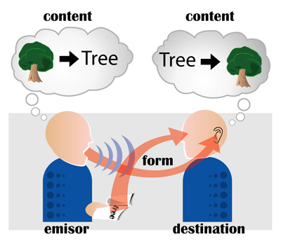
A model for a Communication System
The channel is generally lossy: a part of the transmitted content does not reach its destination or it reaches the destination in a distorted form.

Slide 27
A model for a Communication System
A very important task is the minimization of the loss and the optimum recovery of the original content when it is corrupted by the effect of noise.
A method that is used to improve the efficiency of the channel is called encoding.
An encoded message is less sensitive to noise.

Slide 28
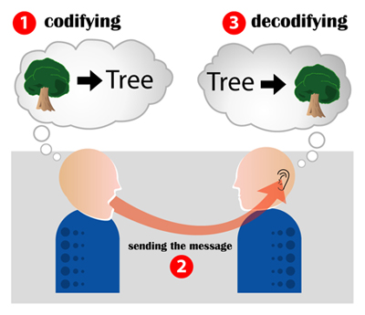
A model for a Communication System
Decoding is employed to transform the encoded messages into the original form, which is acceptable to the receiver.
Encoding: F: I → F(I)
Decoding: F⁻¹: F(I) → I

Slide 29
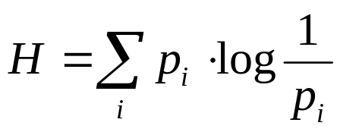
Measures of Information
Hartley defined the first information measure:
  H = n log s
  n is the length of the message and s is the number of possible values for each symbol in the message
  Assumes all symbols equally likely to occur
Shannon proposed variant (Shannon’s Entropy)
    weighs the information based on the probability that an outcome will occur
    second term shows the amount of information an event provides is inversely proportional to its prob of occurring

Slide 30
Measures of Information
To measure the information contained in a message
How much information does a message carry from the sender to the receiver?
Examples
    Ex.2.: Imagine a person sitting in a room. Looking out the window, she can clearly see that the sun is shining. If at this moment she receives a call from a neighbor saying “It is now daytime”, does this message contain any information?
    Ex. 3. : A person has bought a lottery ticket. A friend calls to tell her that she has won first prize. Does this message contain any information?

Slide 31
Examples …
    Ex.2. It does not, the message contains no information. Why? Because she is already certain that is daytime.
    Ex.3. It does. The message contains a lot of information, because the probability of winning first prize is very small
Conclusion
  The information content of a message is inversely proportional to the probability of the occurrence of that message.
  If a message is very probable, it does not contain any information. If it is very improbable, it contains a lot of information

Slide 32
Symbol Information
To measure the information contained in a message, it is needed to measure the information contained in each symbol
      I(s) = log₂ 1/P(s) bits
      Bits is different from the bit, binary digit, used to define a 0 or 1
Examples
    Ex.5. Find the information content of each symbol when the source is binary (sending only 0 or 1 with equal probability)
    Ex. 6. Find the information content of each symbol when the source is sending four symbols with prob. P(S₁) = 1/8, P(S₂) = 1/8, P(S₃) = ¼ ; and P(S₄) = 1/2

Slide 33
Levels of Data Processing
Data Transfer (e.g., communication by the telephone)
Data Selection (e.g., retrieval from a file)
Data Analysis (e.g., sequencing and formatting)
Data Reduction (e.g., replacement of data by a surrogate)

Slide 34
What is Data Transfer?
Simplest level of processing is data transfer or data transmission.
If a sheet of paper containing data is given to someone or if those same data are copied to another medium or sent through a telephone line, the process is that of data transfer. In either event, the recipient has received some level of information as a result of that process even though nothing more may have been done to the data.
Data transfer is measured by the only recognized measure of information. It is that developed by Claude Shannon and used in "information theory" (for which read communication theory). It measures the amount of information (but not its value) by the statistical properties of the signals transmitted.

Slide 35
Measurement of Information for Data Transfer
Let X = (x₁, x₂,...,x_{M}) be a set of signals. Let p_{i} = p(x_{i}) be the a priori probability that signal x_{i} is transferred. Let n_{i} = log(1/p_{i}).
Then, the amount of information conveyed by signal x_{i} is given by
H(x_{i}) = - log(p_{i}) = log(1/p_{i}) = n_{i}
For the set of signals X = (x₁, x₂,...,x_{M}):
H(X) = -  p_{i}*log(p_{i}) =  p_{i}*log(1/p_{i}) =  p_{i}*n_{i}

Slide 36
An Interpretation of n_{i}
The value n_{i} can be interpreted as the average number of binary decisions required to search a file containing the semantic significance of signals. It thus has a role in determining the magnitude of the task involved in dealing with and responding to signals as they are received.
In particular, it measures the size of the files required to store the semantic meaning of signals and the times required to search for and retrieve those meanings.
To illustrate, if all signals are equally likely, p_{i} = 1/N, where N is the total number of signals and thus the size of the semantic file. Hence, n_{i} = log(1/p_{i}) = log(N), which is the number of binary decisions in search of that file.

Slide 37
What is Data Selection?
Best illustrated by operation of a computer database search in which records "relevant to" a request are identified and retrieved from the files.
Note that this process is expected to include data transmission but it also includes much more, since the recipient will receive information as a result of the process of selection, but the amount of information clearly depends upon the degree to which the process of selection indeed identifies "relevant" materials. (For this discussion, the meaning of the term "relevant" will be taken as a primitive, to be interpreted as may be appropriate to specific contexts. )

Slide 38
Measurement of Information for Data Selection
Let X = (x₁, x₂,...,x_{M}) be a set of signals. Let p_{i} = p(x_{i}) be the a priori probability that signal x_{i} is transferred. Let n_{i} = log(1/p_{i}).
Let r_{i} = r(x_{i}) measure the importance of the signal. Such a measure of importance can be illustrated by "relevancy", in the sense in which that term is used in retrieval systems.
The weighted entropy measure for a given signal is given by:
S(x_{i}) = r_{i}*log(1/p_{i}) = r_{i}*n_{i}
For the set of signals X = (x₁, x₂,...,x_{M}):
S(X) = r_{i}*p_{i}*log(1/p_{i}) =  r_{i}*p_{i}*n_{i}

Slide 39
What is Data Analysis?
Illustration: placing data into a format or structure. As a result of that process, the recipient receives information not only from the transmitted data or selected data but from relationships shown in the structure in which they are presented. The sentence "man bites dog" thus is meaningful both because of the data and the "subject-verb-object" syntax of the sentence.
In the context of an information retrieval system, data analysis might be illustrated by sequencing of selected records according to some criterion (by order of relevance, chronologically by date, or alphabetically by author, as examples).
In a database system, it is represented by the creation of matrices, tables, and relationships as means for organization of the data.
In an interactive computer system, it is represented by the formats of displays.
Note that, in each case, the information is conveyed by both a semantic component and a syntactic one (in the format).

Slide 40
The Definition for Semantic Information
Let the source signal be N bits in length (so that we have 2^{N} symbols).
Divide it into F fields of lengths (n₁, n₂,...,n_{F}) bits, averaging N/F. First, suppose that all values for a given field have equal probability. Instead of looking among 2^{N} entries, we need look only among the sum of the (2^{n}i).
The logarithm of that sum will be called “semantic information”, since it is that part of the total symbol that involves table look-up, conveying “meaning”, with the remainder being "syntactic information“, conveyed by the structure.
Note that, as F increases (N being held constant) the amount of semantic information rapidly decreases, and the syntactic information increases.
If the values in a given field have unequal probabilities, their probabilities will again play the same role they do in the Shannon measure.

Slide 41
Illustrative Example
Consider a symbol set that is used to identify people. Each of 16 persons could be uniquely identified by a four-bit array; one would need to have a table with 16 entries in order to determine which person was represented by a given four-bit code.
But now, let's impose a structure on that code:
(Male/Female),(Young/Old),(Rich/Poor),(Urban/Rural)
Suddenly, instead of needing to recognize 16 different things, we need recognize only 8 different things, the combination of which gives us the full set of 16.
Receiving a signal, say 0110, we can identify the category as "male, old, poor, urban"; we have looked at four tables of just two entries each, yet we have identified one from 16 categories.
The logarithm of the size of the set of tables required to interpret the signal is then a measure of the semantic information.

Slide 42
Measurement of Information for Information Organization
Consider a record of F fields. Associate with each possible value in each field an a priori probability; thus for field j and value j_{ji}, there is a probability p(j_{ji}), where for each j, _{i} (p(j_{ji})) = 1.
A given signal is then the combination of a specific set of values, one for each field. The probability of the particular combination, assuming independence, is then the product of the p(j_{ji}), and the amount of information conveyed by the signal is the logarithm of that product. That TOTAL amount of information, however, is more than just the signal, since the structure conveys information as well.
The total, for signal (j_{j1}, j_{j2},…, j_{jM}), therefore is divided between semantic and syntactic as follows:
Semantic Information Syntactic Information
F F F
log( 1/p(j_{ji}))  log(1/p(j_{ji})) - log( 1/p( j_{ji}))
j=1 j=1 j=1

Slide 43
The Size of the Semantic Files
To show the effect of the number of fields, consider a signal of 64 bits. The total number of signals is huge (i.e., 2⁶⁴ which is greater than 10¹⁹), as is the size of the file required to translate each possible signal.
As information is transferred from semantic to syntactic, the number of fields is increased. The result is a dramatic decrease in the size of the semantic files.
Big transfer of information from semantic to syntactic occurs in going from one field (i.e., the signal being treated as a whole) to two fields.

Slide 44
What is Data Reduction?
Best illustrated by the replacement of large collections of data by equations.
For example, linear regression analysis of a set of say 1000 two-dimensional data points replaces 2000 values by two values (the parameters of the linear regression line). The result is information derived both from the process of reduction and from the effective replacement of massive amounts of data by a few parameters.
It can be exemplified by curve fitting, factor analysis, clustering and similar means for reducing large amounts of data to a very limited set of parameters.
In general these mathematical processes can be considered as transformations of the data, treated as a vector space, into alternative dimensional representations in which the original data have nearly zero values on a large number of the transformed dimensions.

Slide 45
Measure for Information in Data Reduction?
The potential measures here are still too speculative.

Slide 46
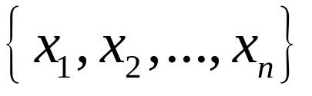
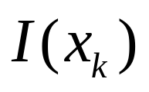
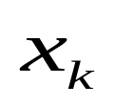

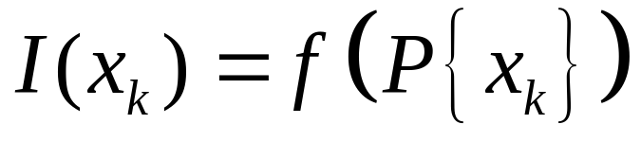
A Quantitative Measure of Information
Suppose we have to select some equipment from a catalog which indicates n distinct models:
The desired amount of information associated with the selection of a particular model must be a function of the probability of choosing :

Slide 47
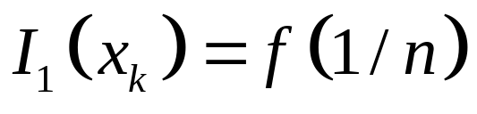
A Quantitative Measure of Information
If, for simplicity, we assume that each one of these models is selected with an equal probability, then the desired amount of information is only a function of n:

Slide 48
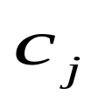
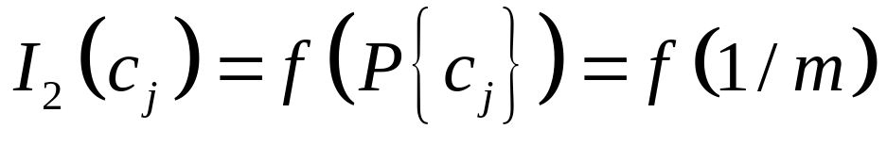
A Quantitative Measure of Information
If each piece of equipment can be ordered in one of m different colors and the selection of colors is also equiprobable, then the amount of information associated with the selection of a color is :

Slide 49
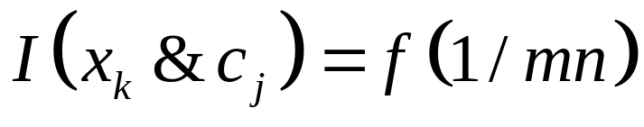
A Quantitative Measure of Information
The selection may be done in two ways:
Select the equipment and then the color independently of each other
Select the equipment and its color at the same time as one selection from mn possible choices:

Slide 50
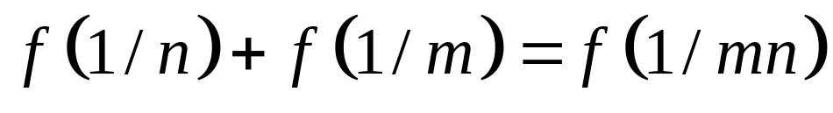
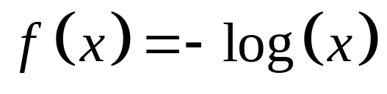
A Quantitative Measure of Information
Since these amounts of information are identical, we obtain:
Among several solutions of this functional equation, the most important for us is:
Thus, when a statistical experiment has n eqiuprobable outcomes, the average amount of information associated with an outcome is log n

Slide 51
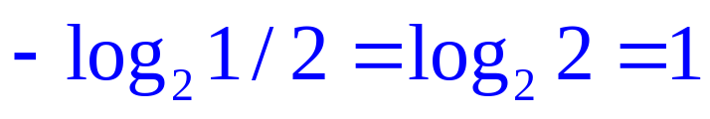
A Quantitative Measure of Information
The logarithmic information measure has the desirable property of additivity for independent statistical experiments.
The simplest case to consider is a selection between two eqiuprobable events. The amount of information associated with the selection of one out of two equiprobable events is and provides a unit of information known as a bit.

Slide 52
The Characterizing Problems
For each of the four levels of processing, there are characterizing problems:
  For data transfer, the problem is “noise”
  For data selection, the problem is “uncertainty”
  For data analysis, the problem is “mismatch between structures”
  For data reduction, the problem is “loss of precision”
The solution to these problems lies in inter-active communications, in which the source and recipient inter-change their roles with the objective of resolving the problems.
Beyond inter-active communication, each process may entail means for avoiding the problems:
  For data transfer, it is adequate bandwidth and redundancy
  For data selection, it is broadened search
  For data analysis, it is inter-active communication
  Fpr data reduction, it again is inter-active communication

Slide 53
Thank you

